Slide 1


Workshop
Membuat website Portofolio dan hosting pada GitHub Pages

Slide 2
Pengenalan
An Nisa Dira
Andre Farhan Saputra
Andri Firman Saputra
Alvin Hendrawan
Azriel FachrulRezy
Lutfi Ruhbi Syahdat
Muhammad Irgi Al Ghithraf
Nixon Milo Hamonangan
Noval Rizky Ramadhan
Yuvita Ratih Dewi

Slide 3
Materi yang akan kita pelajari
01
Git & GitHub
Figma
02
Aplikasi pengelola
Version Control System (VCS)
Aplikasi pembuatan
Desain UI berbasis web
03
HTML
CSS
04
Bahasa markah untuk membuat halaman web
Mengubah tampilan website agar lebih indah

Slide 4


Apa itu Git & GitHub?
Git
GitHub
VS.

Slide 5
Apa itu Git?
Git adalah salah salah satu software Version Control System. Version Control System (VCS) adalah sistem yang mengelola perubahan dari file, baik itu berupa file dokumen, file website, dan jenis file lainnya di dalam folder (repository).
Git menyimpan riwayat perubahan file menggunakan serangkaian commit (history perubahan).

Slide 6
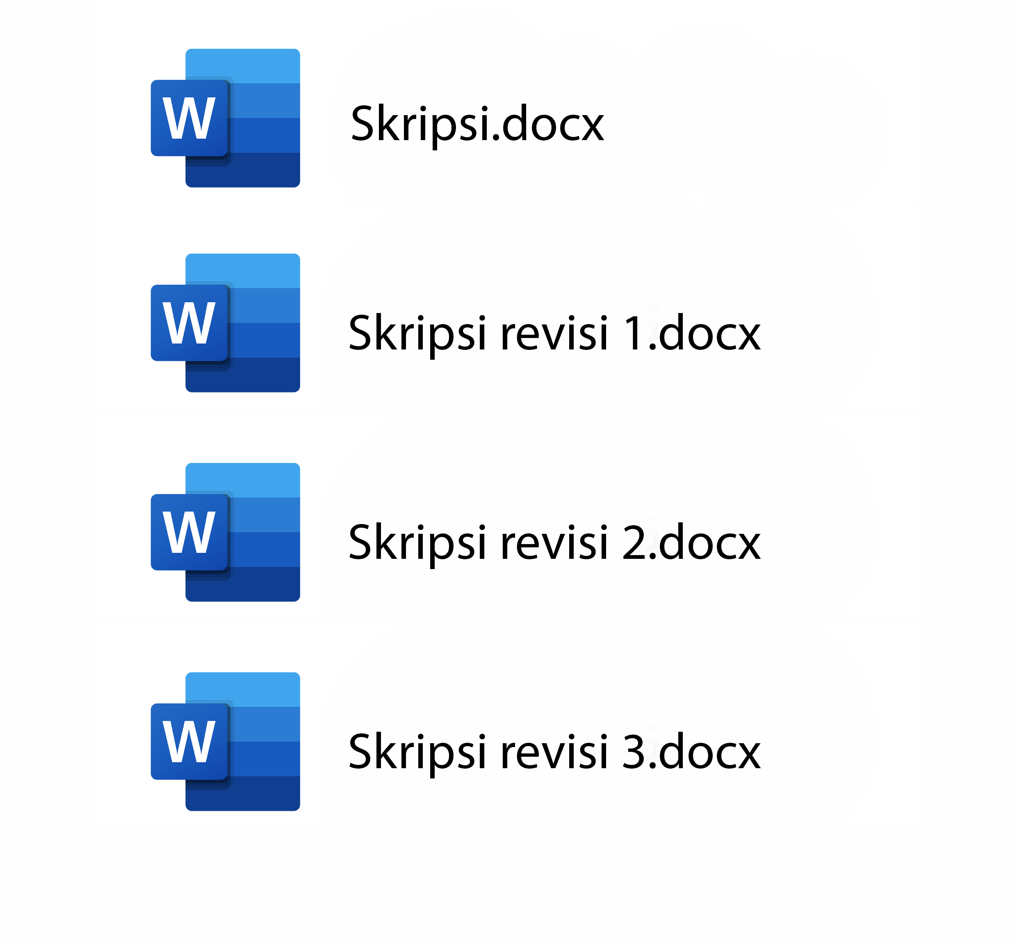
Contoh kasus: tanpa Git
File skripsi kita jadi banyak, padahal hanya mengubah typo penulisan.

Slide 7
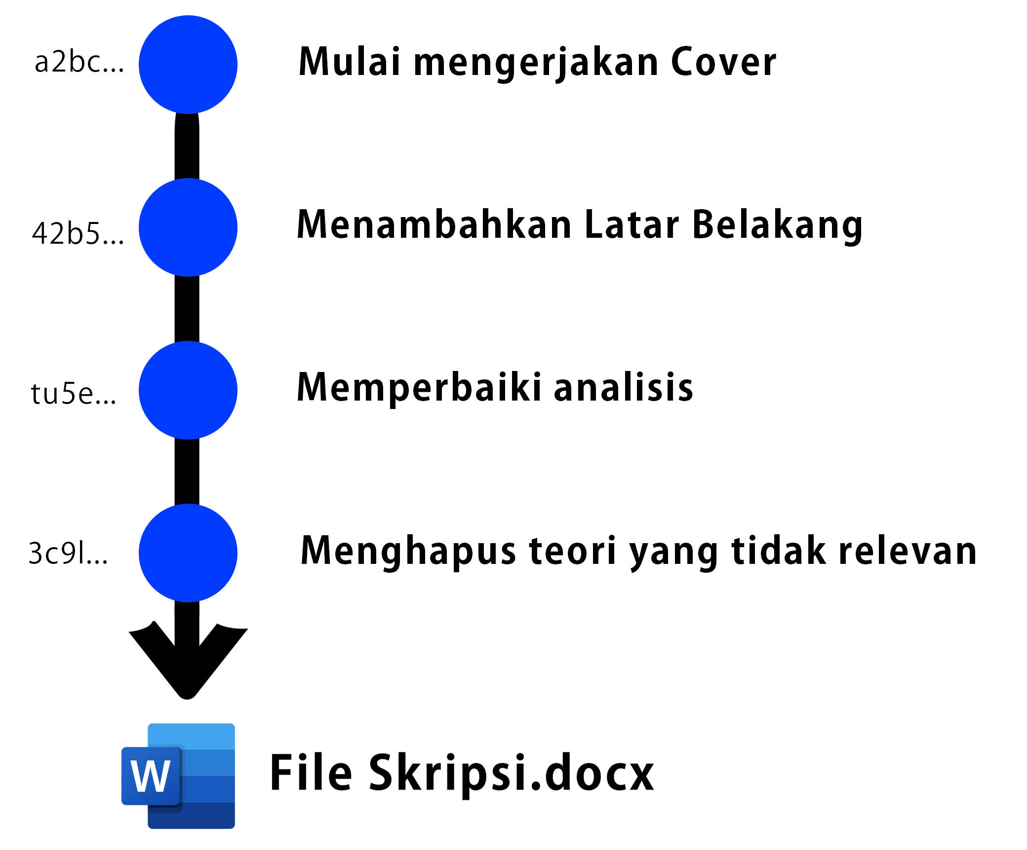
Contoh kasus: dengan Git
HASH
PESAN COMMIT
File skripsi kita hanya satu. Titik biru merupakan commit.

Slide 8
Apa itu GitHub?
GitHub adalah Layanan cloud (penyimpanan online) untuk menyimpan & mengelola project git / repository.
GitHub memiliki fitur yang sama dengan Git, bedanya GitHub dilakukan secara Online.

Slide 9
Version Control System (VCS)
Mercury
Jupiter
1
Mercury is the closest planet to the Sun and the smallest one
Jupiter is a gas giant and the biggest planet in the Solar System
2
Venus
Mars
3
It has a beautiful name and is the second planet from the Sun
Despite being red, it is actually a cold place full of iron oxide dust
4

Slide 10
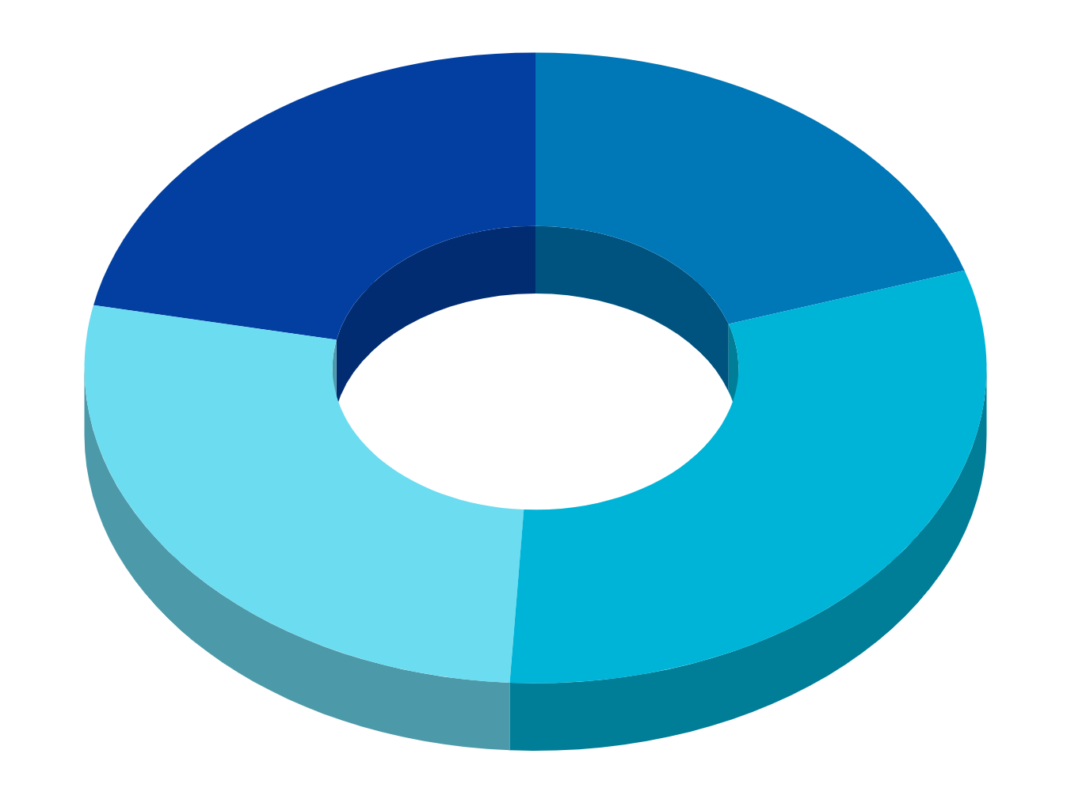
Isometric Clouds Infographics
01
02
Saturn
Mars
It’s composed mostly of hydrogen and helium
Despite being red, Mars is a cold place
03
04
Jupiter
Mercury
The fifth planet from the Sun and the largest one
It is the smallest and innermost planet

Slide 11
Isometric Clouds Infographics
Mars
01
Despite being red, Mars is a cold place. It’s full of iron oxide dust
Mercury
02
Mercury is the closest planet to the Sun and the smallest one
Venus
03
Venus has a beautiful name and is the second planet from the Sun

Slide 12
Isometric Clouds Infographics
Jupiter
1
2
Saturn
Jupiter is the biggest planet
Saturn is the ringed planet
Venus
3
4
Neptune
Venus has a beautiful name
Neptune is the farthest planet

Slide 13
Isometric Clouds Infographics
Venus
Venus has a beautiful name and is the second planet from the Sun
Mars
Despite being red, Mars is actually a cold place full of iron oxide dust
Mercury
Mercury is the closest planet to the Sun and the smallest one

Slide 14
Isometric Clouds Infographics
60%
75%
Mars
Neptune
Despite being red, Mars is a cold place
It’s a gas giant and the biggest planet
53%
61%
Mercury
Venus
Mercury is the closest planet to the Sun
Venus is the second planet from the Sun

Slide 15
Isometric Clouds Infographics
Jupiter is the biggest planet
1
2
It’s a gas giant and has several rings
Despite being red, Mars is cold
3
4
Mercury is the smallest planet
Venus has a beautiful name
5
6
Neptune is the farthest planet

Slide 16
Isometric Clouds Infographics
Saturn
Neptune
Saturn is the ringed one. It’s composed mostly of hydrogen and helium
The reason why Neptune is blue is due to the presence of gas methane
55%
45%

Slide 17
Isometric Clouds Infographics
Mercury
Venus
Mercury is the closest planet to the Sun
Venus is the second planet from the Sun
Mars
Jupiter
Despite being red, Mars is a cold place
It’s the biggest planet in the Solar System

Slide 18
Isometric Clouds Infographics
Jupiter
Mercury
Jupiter is a gas giant and also the biggest planet
Mercury is the closest planet to the Sun
Mars
Venus
Despite being red, Mars is a cold place
Venus is the second planet from the Sun
Neptune
Earth
Neptune is the farthest planet from the Sun
Earth is the only planet that harbors life

Slide 19
Isometric Clouds Infographics
Mercury
Mercury is the closest planet to the Sun
Mars
Despite being red, Mars is a cold place
Venus
Venus is the second planet from the Sun
Neptune
Neptune is the farthest planet from the Sun

Slide 20
Isometric Clouds Infographics
Mars
Venus
Despite being red, Mars is a cold place. It’s full of iron oxide dust
Venus has a beautiful name and is the second planet from the Sun
Mercury
Jupiter
Mercury is the closest planet to the Sun and the smallest one
Jupiter is a gas giant and the biggest planet in the Solar System

Slide 21
Isometric Clouds Infographics
Mercury
Neptune
Mercury is the closest planet to the Sun and the smallest one in the Solar System
Neptune is the farthest planet from the Sun and also the fourth-largest of them all
Mars
Saturn
Despite being red, Mars is a very cold place. The planet is full of iron oxide dust
Earth is the third planet from the Sun and, apparently, the only one that harbors life

Slide 22
Isometric Clouds Infographics
Mercury
Neptune
Mercury is the closest planet to the Sun and the smallest one in the Solar System
Neptune is the farthest planet from the Sun and also the fourth-largest of them all
Mars
Saturn
Despite being red, Mars is a very cold place. The planet is full of iron oxide dust
Earth is the third planet from the Sun and, apparently, the only one that harbors life

Slide 23
Isometric Clouds Infographics
Mars
Despite being red, Mars is a cold place. The planet is full of iron oxide dust
Saturn
Neptune
Saturn is the ringed one. It’s composed mostly of hydrogen and helium
The reason why Neptune is blue is due to the presence of gas methane

Slide 24
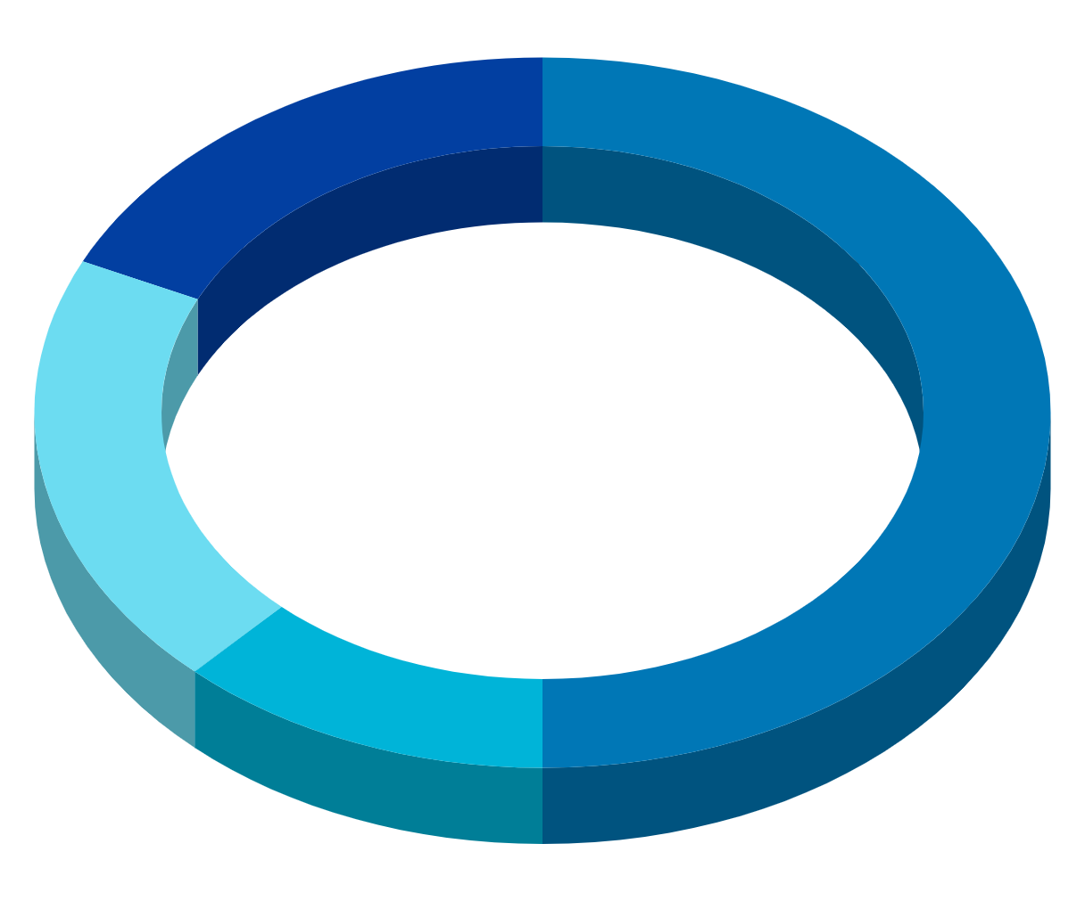
Isometric Clouds Infographics
Jupiter
Saturn
Jupiter is the biggest planet of them all
It’s a gas giant and has several rings
Mars
Neptune
Despite being red, Mars is actually cold
It’s the farthest planet from the Sun
Earth
Mercury
Earth is the third planet from the Sun
It’s the closest planet to the Sun

Slide 25
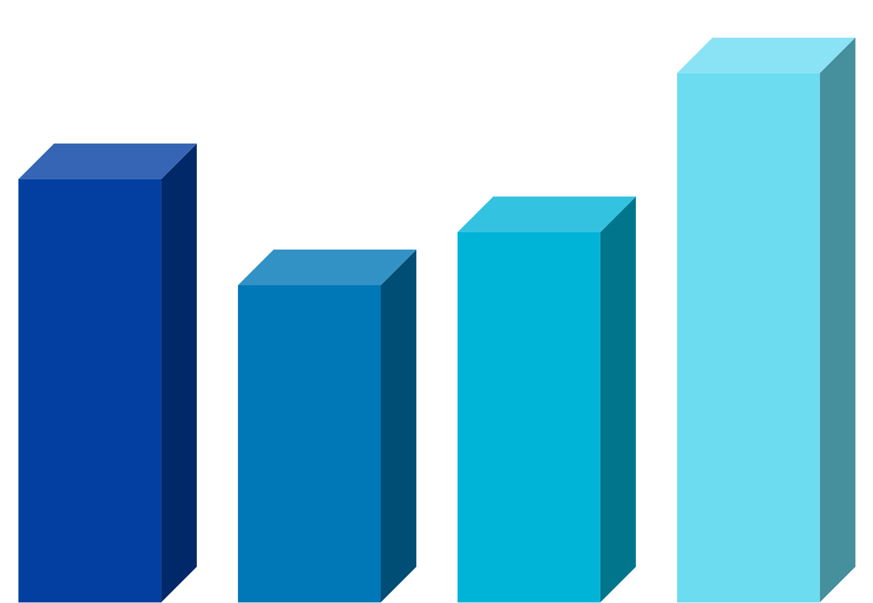
Isometric Clouds Infographics
Jupiter
Saturn
Jupiter is the biggest planet of them all
It’s a gas giant and has several rings
Mars
Neptune
Despite being red, Mars is actually cold
It’s the farthest planet from the Sun

Slide 26
Isometric Clouds Infographics
01
02
Saturn
Mars
It’s composed mostly of hydrogen and helium
Despite being red, Mars is a cold place
03
04
Jupiter
Mercury
The fifth planet from the Sun and the largest one
It is the smallest and innermost planet

Slide 27
Isometric Clouds Infographics
Venus
Venus has a beautiful name and is the second planet from the Sun
Mercury
Mercury is the closest to the Sun and the smallest of them all
Mars
Despite being red, it’s a cold place full of iron oxide dust
Jupiter
Jupiter is a gas giant and the biggest planet in the Solar System

Slide 28
Isometric Clouds Infographics
01
Mercury is the closest planet to the Sun
Mercury
02
Venus is the second planet from the Sun
Venus
03
Big Data
Jupiter is a gas giant and the biggest planet
Jupiter
04
Yes, this is the ringed one. It’s a gas giant
Saturn

Slide 29
Isometric Clouds Infographics
Jupiter
Venus
It’s a gas giant and the biggest planet
It’s the second planet from the Sun
Mars
Neptune
Despite being red, it’s a very cold place
This is the farthest planet from the Sun
Mercury
Saturn
It’s the smallest planet of them all
Yes, this is the ringed one and a gas giant

Slide 30
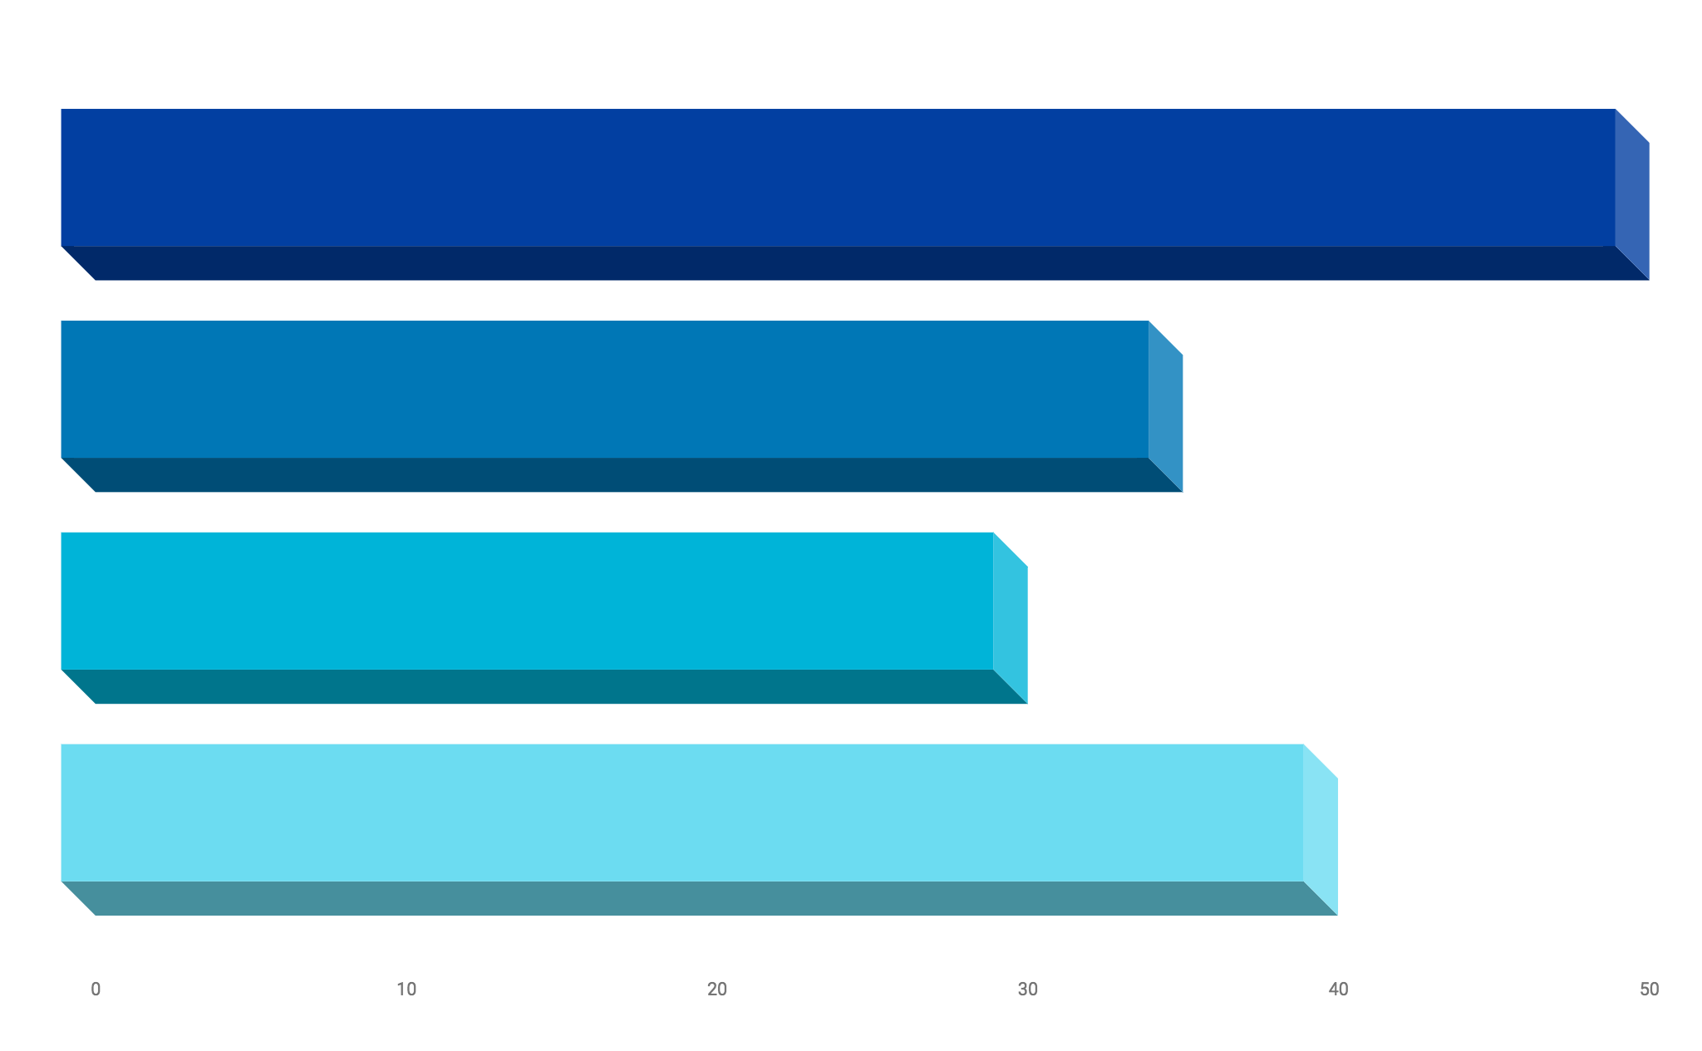
Isometric Clouds Infographics
Jupiter
It’s a gas giant and the biggest planet
Mars
Despite being red, Mars is a cold place
Mercury
It’s the closest planet to the Sun
Saturn
It’s the ringed one and a gas giant

Slide 31
Isometric Clouds Infographics
01
Venus has a beautiful name and is the second one from the Sun
02
Mercury is the closest planet to the Sun and the smallest one
03
Despite being red, Mars is a cold place full of iron oxide dust
Venus
50%
Mercury
70%
04
Mars
70%
Jupiter
40%
It’s a gas giant and the biggest planet in the Solar System

Slide 32
Isometric Clouds Infographics
Mars
Saturn
Despite being red, Mars is a cold place
It’s a gas giant and the biggest planet
Mercury
Venus
Mercury is the closest planet to the Sun
Venus is the second planet from the Sun

Slide 33
Isometric Clouds Infographics
Venus is a planet that has a really beautiful name and is the second planet from the Sun
Mars is a cold desert world. It is half the size of Earth. Mars is sometimes called the Red Planet
Jupiter is the biggest planet in our solar system. It's similar to a star, but it never got big enough
Saturn isn’t the only planet to have rings, but it definitely has the most beautiful ones

Slide 34
Isometric Clouds Infographics
50%
Venus
Venus is the second planet from the Sun
Mars
Despite being red, Mars is a cold place
20%
Mercury
30%
It’s the closest planet to the Sun

Slide 35
Instructions for use (free users)
In order to use this template, you must credit Slidesgo by keeping the Thanks slide.
You are allowed to:
Modify this template.
Use it for both personal and commercial purposes.
You are not allowed to:
Sublicense, sell or rent any of Slidesgo Content (or a modified version of Slidesgo Content).
Distribute this Slidesgo Template (or a modified version of this Slidesgo Template) or include it in a database or in any other product or service that offers downloadable images, icons or presentations that may be subject to distribution or resale.
Use any of the elements that are part of this Slidesgo Template in an isolated and separated way from this Template.
Delete the “Thanks” or “Credits” slide.
Register any of the elements that are part of this template as a trademark or logo, or register it as a work in an intellectual property registry or similar.
For more information about editing slides, please read our FAQs or visit Slidesgo School:
https://slidesgo.com/faqs and https://slidesgo.com/slidesgo-school

Slide 36
Instructions for use (premium users)
In order to use this template, you must be a Premium user on Slidesgo.
You are allowed to:
Modify this template.
Use it for both personal and commercial purposes.
Hide or delete the “Thanks” slide and the mention to Slidesgo in the credits.
Share this template in an editable format with people who are not part of your team.
You are not allowed to:
Sublicense, sell or rent this Slidesgo Template (or a modified version of this Slidesgo Template).
Distribute this Slidesgo Template (or a modified version of this Slidesgo Template) or include it in a database or in any other product or service that offers downloadable images, icons or presentations that may be subject to distribution or resale.
Use any of the elements that are part of this Slidesgo Template in an isolated and separated way from this Template.
Register any of the elements that are part of this template as a trademark or logo, or register it as a work in an intellectual property registry or similar.
For more information about editing slides, please read our FAQs or visit Slidesgo School:
https://slidesgo.com/faqs and https://slidesgo.com/slidesgo-school

Slide 37
Infographics
You can add and edit some infographics to your presentation to present your data in a visual way.
Choose your favourite infographic and insert it in your presentation using Ctrl C + Ctrl V or Cmd C + Cmd V in Mac.
Select one of the parts and ungroup it by right-clicking and choosing “Ungroup”.
Change the color by clicking on the paint bucket.
Then resize the element by clicking and dragging one of the square-shaped points of its bounding box (the cursor should look like a double-headed arrow). Remember to hold Shift while dragging to keep the proportions.
Group the elements again by selecting them, right-clicking and choosing “Group”.
Repeat the steps above with the other parts and when you’re done editing, copy the end result and paste it into your presentation.
Remember to choose the “Keep source formatting” option so that it keeps the design. For more info, please visit Slidesgo School.

